Slide 1

How We Build Our Rosters And Why
Goal: capture the best 22 players. Coach them at the highest level we can. Get the best 22 players “in form” and keep them match fit.

Slide 2
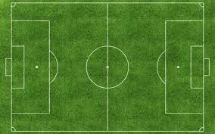
Varsity Reserve Match Day
Varsity
Reserve/JV
11
+4
+3
=18
4
+4
+3
=11

Slide 3
What Practice Looks Like
22
14

